Slide 1

Type Checking (P.341)
A compiler has to do semantic checks in addition to syntactic checks.
Semantic Checks
  Static – done during compilation
  Dynamic – done during run-time
Type checking is one of these static checking operations.
  we may not do all type checking at compile-time.
  Some systems also use dynamic type checking too.
Token stream
Syntax tree
Syntax tree
Intermediate
code generator
IR
parser
Type
checker

Slide 2
Type system (P.344)
A type system is a collection of rules for assigning type expressions to the parts of a program.
A type checker implements a type system.
A sound type system eliminates run-time type checking for type errors.
A programming language is strongly-typed, if every program its compiler accepts will execute without type errors.
  In practice, some of type checking operations are done at run-time (so, most of the programming languages are not strongly-typed).
  Ex: int x[100]; … x[i] ➔ most of the compilers cannot guarantee that i will be between 0 and 99

Slide 3
Type Expression (P.345)
The type of a language construct is denoted by a type expression.
A type expression can be:
  A basic type
    a primitive data type such as integer, real, char, boolean, …
    type-error to signal a type error
    void : no type
  A type name
    a name can be used to denote a type expression.
Notes:
给定一组域D1,D2,…,
Dn，这些域中可以有相同的。 D1,D2,…,Dn的笛卡尔积（cartesian product）为: D1 x D2
x … x Dn={ (d1,d2,…,dn) | di∈ Di, i=1,2,…,n }.

Slide 4
Type Expression (cont.)
  A type constructor applies to other type expressions.
    arrays: If T is a type expression, then array(I,T) is a type expression where I denotes index range. Ex: array(0..99,int)
    products: If T₁ and T₂ are type expressions, then their cartesian product T₁ x T₂ is a type expression. Ex: int x int
    pointers: If T is a type expression, then pointer(T) is a type expression. Ex: pointer(int)
    functions: We may treat functions in a programming language as mapping from a domain type D to a range type R. So, the type of a function can be denoted by the type expression D→R where D are R type expressions. Ex: int→int represents the type of a function which takes an int value as parameter, and its return type is also int.
Notes:
笛卡尔积（cartesian product）

Slide 5
A Simple Type Checking System (P.348)
The type checker is a translation scheme that synthesizes the type of each expression from the types of its sub-expressions.
P → D; E
D → D; D
D → id: T { addtype(id.entry,T.type) }
T → char { T.type=char }
T → int { T.type=int }
T → real { T.type=real }
T → ↑T₁ { T.type=pointer(T₁.type) }
T → array[intnum] of T₁ { T.type=array(0..intnum.val,T₁.type) }

Slide 6
Type Checking of Expressions (P.350)
E → id { E.type=lookup(id.entry) }
E → charliteral { E.type=char }
E → intliteral { E.type=int }
E → realliteral { E.type=real }
E → E₁ + E₂ { if (E₁.type=int and E₂.type=int) then E.type=int
else if (E₁.type=int and E₂.type=real) then E.type=real
else if (E₁.type=real and E₂.type=int) then E.type=real
else if (E₁.type=real and E₂.type=real) then E.type=real
else E.type=type-error }
E → E₁ [E₂] { if (E₂.type=int and E₁.type=array(s,t)) then E.type=t
else E.type=type-error }
E → ↑ E₁ { if (t=pointer(E1.type)) then E.type=t
else E.type=type-error }

Slide 7
Type Checking of Statements (P.351)
S → id = E { if (id.type=E.type then S.type=void
else S.type=type-error }
S → if E then S₁ { if (E.type=boolean then S.type=S₁.type
else S.type=type-error }
S → while E do S₁ { if (E.type=boolean then S.type=S₁.type
else S.type=type-error }
S → S₁; S₂ { if (S₁.type=void and S₂.type=void then S.type=void
else S.type=type-error }

Slide 8
Type Checking of Functions (P.352)
E → E₁ ( E₂ ) { if (E₂.type=s and E₁.type=s→t) then E.type=t
else E.type=type-error }
Ex: int f(double x, char y) { ... }
f: double x char → int
argument types return type

Slide 9
Structural Equivalence of Type Expressions (P.353)
How do we know that two type expressions are equal?
As long as type expressions are built from basic types (no type names), we may use structural equivalence between two type expressions
Structural Equivalence Algorithm (sequiv):
if (s and t are same basic types) then return true
else if (s=array(s₁,s₂) and t=array(t₁,t₂)) then return (sequiv(s₁,t₁) and sequiv(s₂,t₂))
else if (s = s₁ x s₂ and t = t₁ x t₂) then return (sequiv(s₁,t₁) and sequiv(s₂,t₂))
else if (s=pointer(s₁) and t=pointer(t₁)) then return (sequiv(s₁,t₁))
else if (s = s₁ → s₂ and t = t₁ → t₂) then return (sequiv(s₁,t₁) and sequiv(s₂,t₂))
else return false

Slide 10
Names for Type Expressions (P.356)
In some programming languages, we give a name to a type expression, and we use that name as a type expression afterwards.
type link = ↑ cell;
var p,q : link;
var r,s : ↑ cell
How do we treat type names?
  Get equivalent type expression for a type name (then use structural equivalence), or
  Treat a type name as a basic type.
p,q,r,s have same types ?
Under name equivalence, p and r do not have the same type, however, under structural equivalence, all variables p, q, r and s have the same type.

Slide 11
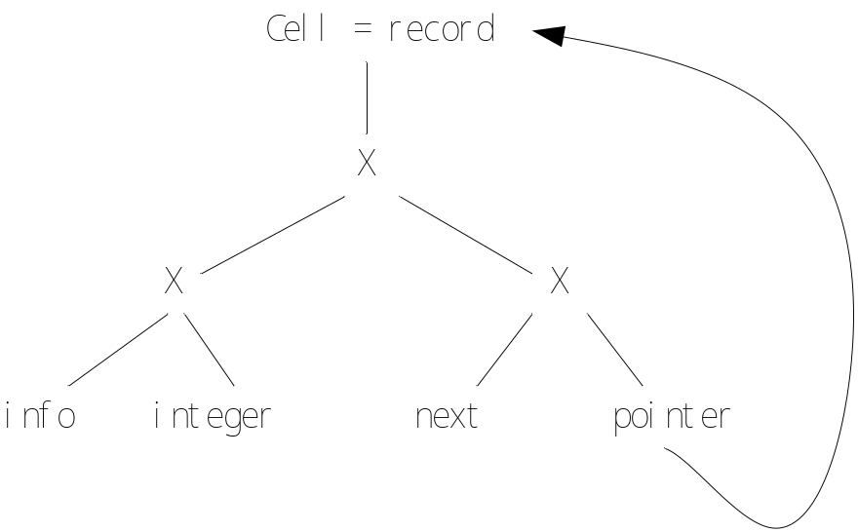
Cycles in Type Expressions (P.358)
type link = ↑ cell;
type cell = record
info : int,
next : link
end;
The type name link is defined in terms of cell and that cell is defined in terms of link, so their definitions are recursive.
We cannot use structural equivalence if there are cycles in type expressions.
We have to treat type names as basic types.
  ➔ but this means that the type expression link is different than the type expression ↑cell.
Notes:
Pascal declaration of type names

Slide 12
Type Coercions (P.359)
x + y
What kind of codes we have to produce, if the type of x is double and the type of y is int?
inttoreal t1,,y
real+ t2,x,t1 (addf $f3,$f1,$f2)
what is the type of this expression (int or double)?
t2
x
t1
Notes:
Implicit----coercion
explicit

Slide 13
Overloading (P.361)
Expressions might have a multitude of types.
E → id {E.types = lookup(id.entry)}
E → E₁+E₂ {E.types = { t | there exists a type in E₁.types and E₂.types simultaneously }
E → E₁(E₂) {E.types = { t | there exists a s in E₂.types such that s→t belongs to E₁.types }
An overloaded symbol is one that has different meanings depending on its context.
  The type of E is determined by looking at the possible types of E₁ and E₂.
Type error will occur when E.types becomes empty for some expression.

Slide 14
Exercises (think)
P.381 6.2, 6.10

Slide 15
1、对于输入的表达式(4*7+1)*2，根据下表的语法制导定义建立一棵带注释的分析树。
val:表示非终结符的整数值,综合属性,lexval 是单词 digit 的属性
语法制导定义如下：
产生式 | 语义规则
L →E | print(E.val)
E →E¹+T | E.val:=E¹.val+T.val
E →T | E.val:=T.val
T →T¹*F | T.val:=T¹.val*F.val
T →F | T.val:=F.val
F →(E) | F.val:=E.val
F →digit | F.val:=digit.lexval

Slide 16
2、请按语法制导的定义，将后缀表达式翻译成中缀表达式。注意，不允许出现冗余括号，后续表达式的文法如下：
E->EE+
E->EE*
E->id

Slide 17
3、下面文法产生的表达式是对整型和实型常数应用算符+形成的。当两个整数相加时,结果为整数，否则为实数。
E→ TR
R →+ TR|ε
T→num.num | num
a)给出语法制导定义确定每个子表达式的类型。
b) 把表达式翻译成前缀形式，并且决定类型。试用一元运算符inttoreal把整型值转换为相等的实型值，以使得前缀表达式中两个运算对象是同类型的。

